Slide 1
Implementation of Login using php and MySQL
CT4009
Week 8 – Lab Worksheet

Slide 2
Purpose of this lab…
Implementation of “Flogger Item List” page that displays a list of items for sale and their images.
Prerequisite: You have completed Week 7 Lab Work

Slide 3
Set up your Folders…
Last week we created 3 folders (include, SellItem, ItemImages)
Add another folder for this week lab work
ShowAllItems – this should contain the following 5 files
ShowAllItems.html (Read database item table and show the item list in this page)
ShowAllItems.js (send request to php and display returned data in the html page)
ShowAllItemsDAO.php (Read both item and item image tables and return data to javascript)
ShowItemImages.html (shows item images of a specific item)
ShowItemImages.js (send request to php and display returned item images in the html page)

Slide 4
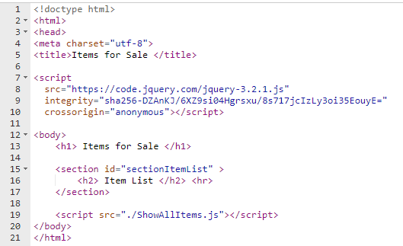
ShowAllItems.html
Container for dynamic item list

Slide 5
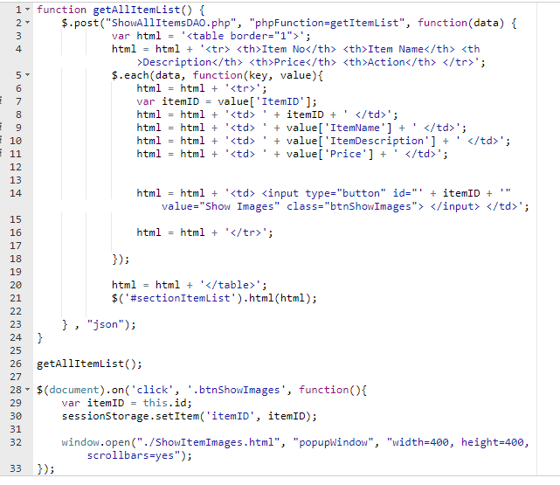
ShowAllItems.js
We are using post function for sending request to php which works same way as ajax function
Create a dynamic table for item list
Create a button for each item clicking on which open a new page that shows images of the item
Event handler for show image button created above

Slide 6
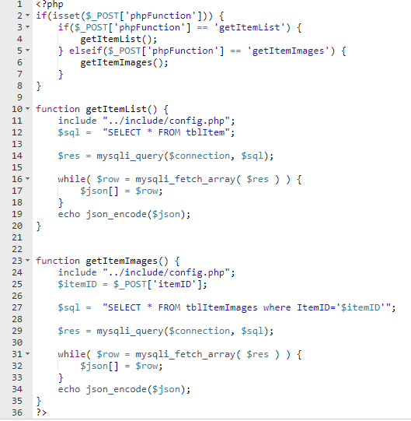
ShowAllItemsDAO.php
Contain two functions: 1) to read data from item table 2) to read data from item images table
Calls the right function requested from javascript
Returns item list from the database table
Returns item image names from database table for a specific item

Slide 7
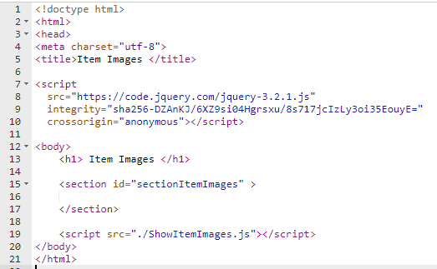
ShowItemImages.html
Container for dynamic item images

Slide 8
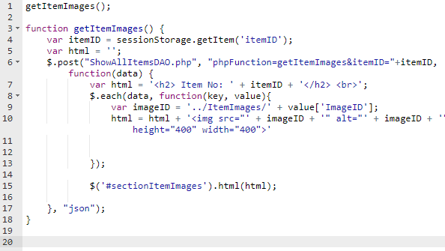
ShowItemImages.js
Create image objects that link to the physical image files in the ItemImages folder

Slide 9
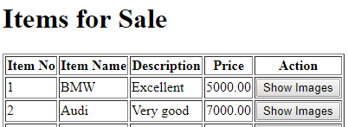
Upload files and folders
Upload all the implemented files and folder to your studentsites server (in public_html folder)
Open ShowAllItems.html in a browser window
You will see an item list (you should insert some sample items first by using the page implemented last week). An example of this page is given below:
Click Show Images button that will open a pop-up window and show item images of an individual item

